Slide 1
Graph Neural Networks for Graph Query Matching & Graphs Isomorphism Counting lecture-10 Course on Graph Neural Networks (Winter Term 21/22)
Prof. Dr. Holger Giese (holger.giese@hpi.de)
Christian Medeiros Adriano (christian.adriano@hpi.de) - “Chris”
Matthias Barkowski (matthias.barkowski@hpi.de)

Slide 2
Intro
Graph Isomorphisms consists of counting the number of subgraphs in graph database that present the same configuration of nodes and edges.
Graph Matching consists of finding the number of graphs that match a given query, which is represented by a graph.
Graph Isomorphism Counting
Graph Query Matching

Slide 3
Two fundamental challenges of GNNs
Expressivity = repeated neighbor mixing collapses embeddings of different nodes into a fixed low-dimensional subspace.
Scalability = recursive expansion of neighbor nodes results in exponentially growing neighborhood size.

Slide 4
Graph Query Matching
Goal: find out the query graph from the data graph, i.e., it is a search problem that involves ranking results (matches)

Slide 5
Neuro Subgraph Matching [Ying 2020]
Limitations of previous work (Bai et al., 2019; Li et al., 2019; Xu et al., 2019):
embed graphs into vector spaces
→ do not impose geometric structure in the embedding space.
→
Conversely, using a GNN creates an ordered embedding that
→leads to a well-structured embedding space
→to efficiently navigate it in order to find subgraphs as well as supergraph
source: Ying, R., Lou, Z., You, J., Wen, C., Canedo, A., & Leskovec, J. (2020). Neural Subgraph Matching
Notes:
Yunsheng Bai, Hao Ding, Song Bian, Ting Chen, Yizhou Sun, and Wei Wang. Simgnn: A neural network approach to fast graph similarity computation. In WSDM. ACM, 2019
Yujia Li, Chenjie Gu, Thomas Dullien, Oriol Vinyals, and Pushmeet Kohli. Graph matching networks for learning the similarity of graph structured objects. In ICML, 2019.
Kun Xu, Liwei Wang, Mo Yu, Yansong Feng, Yan Song, Zhiguo Wang, and Dong Yu. Cross-lingual knowledge graph alignment via graph matching neural network. 2019

Slide 6
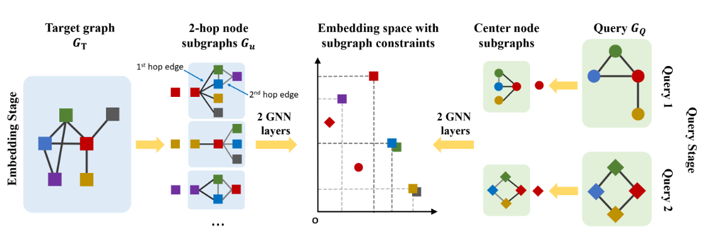
Framework of Neuro Subgraph Matching [Ying 2020]
Max-margin loss is used to ensure that the subgraph relationships are captured
GNN is trained to learn the order embedding
source: Ying, R., Lou, Z., You, J., Wen, C., Canedo, A., & Leskovec, J. (2020). Neural Subgraph Matching

Slide 7
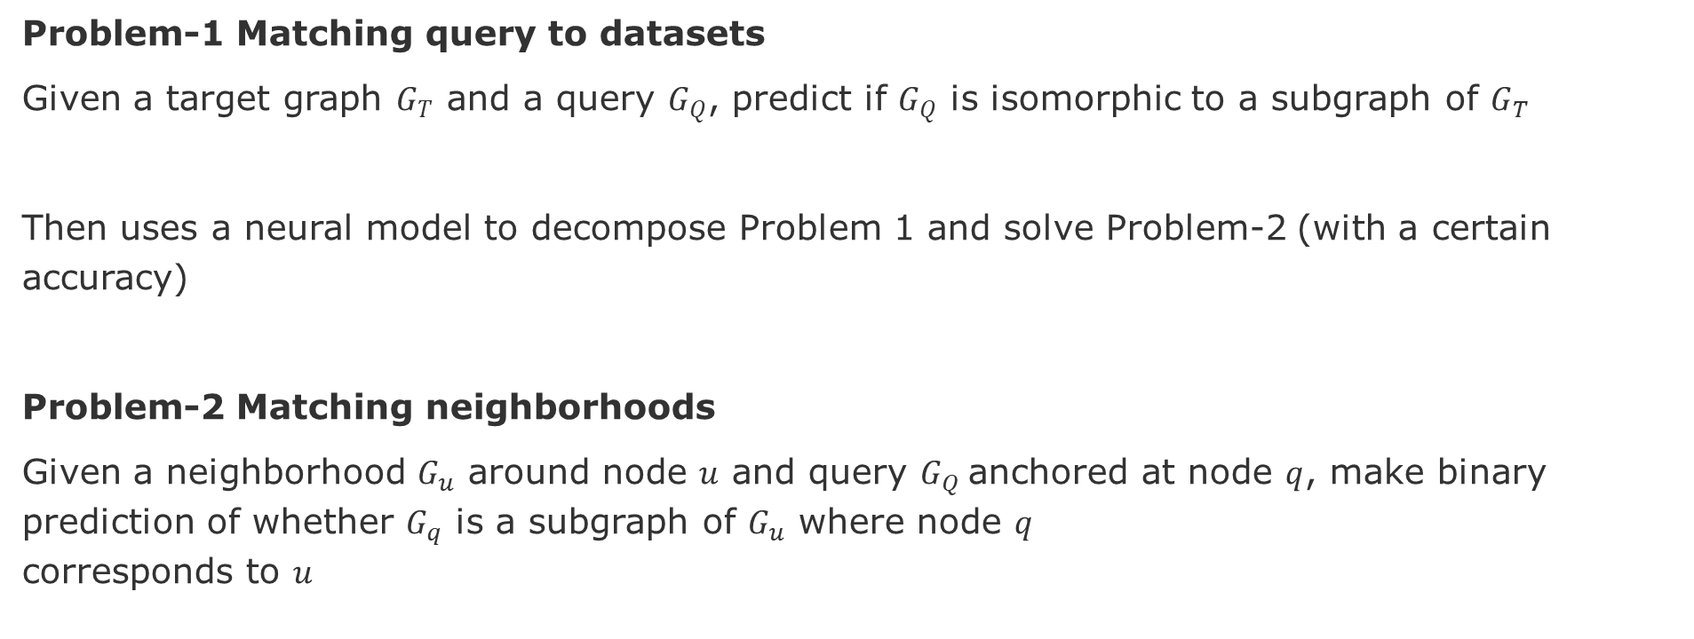
Decision problems of subgraph matching
Problem-1 Matching query to datasets
Given a target graph $G_{T}$ and a query $G_{Q}$, predict if $G_{Q}$ is isomorphic to a subgraph of $G_{T}$
Then uses a neural model to decompose Problem 1 and solve Problem-2 (with a certain accuracy)
Problem-2 Matching neighborhoods
Given a neighborhood $G_{u}$ around node $u$ and query $G_{Q}$anchored at node $q$, make binary prediction of whether $G_{q}$ is a subgraph of $G_{u}$ where node $q$ corresponds to $u$
Caveat - GNNs are good at similarity measurement tasks but are not good at substructure extraction tasks: shortest path, subgraph, self-loop, etc.

Slide 8
References Graph Query Matching
Ying, Z., Wang, A., You, J., Wen, C., Canedo, A., & Leskovec, J. (2020). Neural subgraph matching.
Lan, Z., Yu, L., Yuan, L., Wu, Z., Niu, Q., & Ma, F. (2021). Sub-GMN: The Subgraph Matching Network Model. arXiv preprint arXiv:2104.00186.
Sarlin, P. E., DeTone, D., Malisiewicz, T., & Rabinovich, A. (2020). Superglue: Learning feature matching with graph neural networks. In Proceedings of the IEEE/CVF, pp. 4938-4947. Data and code are available at https://github.com/magicleap/SuperGluePretrainedNetwork
Krleža, D., & Fertalj, K. (2016). Graph matching using hierarchical fuzzy graph neural networks. IEEE Transactions on Fuzzy Systems, 25(4), 892-904.
Zhou, J., Cui, G., Hu, S., Zhang, Z., Yang, C., Liu, Z., ... & Sun, M. (2020). Graph neural networks: A review of methods and applications. AI Open, 1, 57-81.
your suggestion?

Slide 9
Graph Isomorphism Counting
Goal: find the number of query graphs (isomorphism, graph structures) in the data graph.

Slide 10
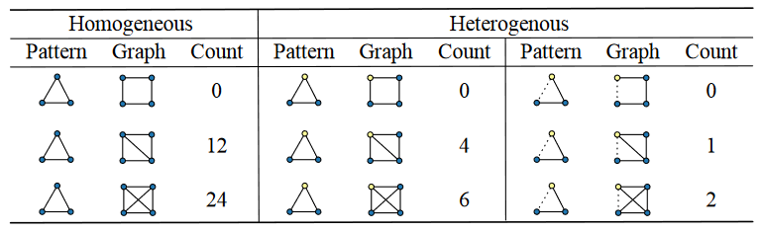
Different Settings for Counting
Homogeneous graphs
Heterogeneous vertex graphs
two types of nodes
Heterogeneous vertex and heterogeneous edge graphs
two types of nodes and two types of edges
A
B
C
source: Liu et al., 2020, Neural Subgraph Isomorphism Counting, KDD '20
Notes:
Liu et al., 2020, Neural Subgraph Isomorphism Counting, KDD '20, August 23–27, 2020

Slide 11
Intuition of the Graph Counting Problem
The counting problem can be formulated as a question-answering problem well established in natural language processing, but with slight difference in the outcome:
Question Answering Model (Text Queries):
answers are facts extracted from the provided texts
Graph Counting Model:
answers are summary statistics of matched local patterns.
source: Liu et al., 2020, Neural Subgraph Isomorphism Counting, KDD '20

Slide 12
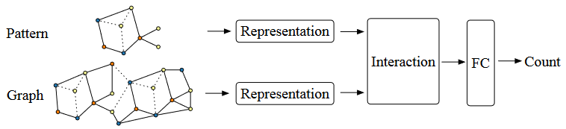
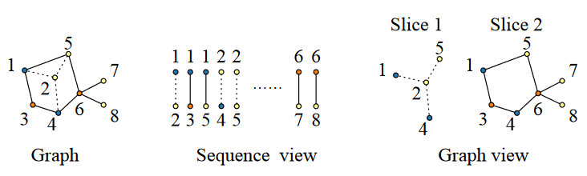
Framework of neural subgraph isomorphism counting models [Liu 2020]
Encoding makes the problem learnable.
Caveat: Learning based approaches are inexact
Query
Graph database
A
B
Encoding the graph (or the pattern) should be either represented:
sequence of edges, or
a series of adjacent matrices and vertex features.
source: Liu et al., 2020, Neural Subgraph Isomorphism Counting, KDD '20

Slide 13
Results [Liu et al. 2020]
Generalized to count large patterns and data graphs in linear time compared to the exponential time of the original NP-complete problem.
Experimental results showed that learning based subgraph isomorphism counting can speed up the traditional algorithm (VF2) in up to 1000 times with acceptable errors.
Data and code are available at https://github.com/HKUST-KnowComp/NeuralSubgraphCounting

Slide 14
References Graph Isomorphism Counting
Liu, X., Pan, H., He, M., Song, Y., Jiang, X., & Shang, L. (2020, August). Neural subgraph isomorphism counting. In Proceedings of the 26th ACM SIGKDD, pp. 1959-1969, Data and code are available at https://github.com/HKUST-KnowComp/NeuralSubgraphCounting
Bouritsas, G., Frasca, F., Zafeiriou, S., & Bronstein, M. M. (2020). Improving graph neural network expressivity via subgraph isomorphism counting. arXiv preprint arXiv:2006.09252
Chen, Z., Chen, L., Villar, S., & Bruna, J. (2020). Can graph neural networks count substructures?. arXiv preprint arXiv:2002.04025.
Tahmasebi, B., Lim, D., & Jegelka, S. (2020). Counting substructures with higher-order graph neural networks: Possibility and impossibility results. arXiv preprint arXiv:2012.03174.
You, J., Gomes-Selman, J., Ying, R., & Leskovec, J. (2021). Identity-aware graph neural networks. arXiv preprint arXiv:2101.10320.
… your suggestion?

Slide 15
Next tasks
Choose one or two papers to read.
Write a gist with 4 lines for each item below:
Problem (what is it, why is it important, what were the challenges)
Approach (encoding, loss function, message-passing-aggregation/algorithm)
Evaluation (baseline graph models, metrics, competing algorithms)
Share your comments on Slack before the lecture
#sota-graph-query-matching
#sota-graph-isomorphism-counting
Present next Wednesday
decide the group topic and
start narrowing the specific approach

Slide 16
Advanced Topics

Slide 17
End

Slide 18
GNNs and Weisfeiler-Lehman Isomorphism Test
4- Weisfeiler and lehman go topological: Message passing simplicial networks, 2021 https://www.hpi.uni-potsdam.de/giese/bibadmin/show.php?id=17130
5- The Power of the Weisfeiler-Leman Algorithm for Machine Learning with Graphs, 2021
https://www.hpi.uni-potsdam.de/giese/bibadmin/show.php?id=17134
6- word2vec, node2vec, graph2vec, x2vec: Towards a theory of vector embeddings of structured data, 2020
https://www.hpi.uni-potsdam.de/giese/bibadmin/show.php?id=17149

Slide 19
Querying with GNNs
7- The expressive power of graph neural networks as a query language, 2020
https://www.hpi.uni-potsdam.de/giese/bibadmin/show.php?id=17147
8- Representing Schema Structure with Graph Neural Networks for Text-to-SQL Parsing, 2019
https://www.hpi.uni-potsdam.de/giese/bibadmin/show.php?id=17146
9- The relational data borg is learning
https://www.hpi.uni-potsdam.de/giese/bibadmin/show.php?id=17148

Slide 20
Equivariance and Expressiviness of GNNs
10- Expressive power of invariant and equivariant graph neural networks, 2020
https://www.hpi.uni-potsdam.de/giese/bibadmin/show.php?id=17139
11- Equivariant Subgraph Aggregation Networks, 2021
https://www.hpi.uni-potsdam.de/giese/bibadmin/show.php?id=17136

Slide 21
Search Plan Generation
https://link.springer.com/chapter/10.1007/11841883_27 (static search plans)
https://link.springer.com/article/10.1007/s10270-013-0372-2 (static search plans)
https://journal.ub.tu-berlin.de/eceasst/article/view/268 (dynamic search plans)
https://link.springer.com/chapter/10.1007/978-3-030-23611-3_13 (hybrid search plans; heuristic used in our tool)
LDBC Social Network Benchmark
https://dl.acm.org/doi/pdf/10.1145/2723372.2742786 (initial paper)
https://arxiv.org/abs/2001.02299 (full documentation)
https://github.com/ldbc/ldbc_snb_interactive (repo)
Best regards,
Matthias

